Slide 1
New York City Taxi Fare Prediction (Machine Learning Approach)
By
Marcel I Ngwueke
Springboard Data Science Career Track, May 2021 cohort
Capstone 2 Project

Slide 2
Table of Contents
Problem Statement:
Business Definition
Business Objective
Data Collection
Data Wrangling
Exploratory Data Analysis (EDA)
Model Assessments
Machine Learning
Conclusion

Slide 3
Problem Statement
Business Definition:
Which of the data attributes influence the New York City Fare?
When most and where most do the fare increase or decrease?
New York City Fare Prediction is ML based
Distance, trip time, hour of day and day of week could have impacted positively or negatively
Business Objective:
Determine which of the ML models accurately predict New York City Taxi fare.

Slide 4
Data Collection
Data source:
https://www.kaggle.com/c/new-york-city-taxi-fare-prediction/data
Composed of 3 datasets:
Train.csv has 55 million rows and 8 columns
Test.csv has 9914 rows and 7 columns
Sample_submission.csv has 9914 rows and 2 columns
Train.csv ➔ df_train {columns= keys, fare_amount, pickup_datetime, pickup_longitude, pickup_latitude, dropoff_longitude, dropoff_latitude, and passenger_count}
Test.csv➔ df_test {same as df_train without fare_amount}
Sample_submission.csv➔ df_sample_submission{key, fare_amount}

Slide 5
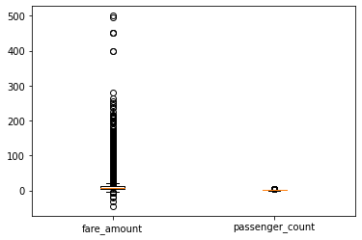
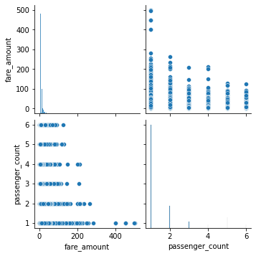
Data Wrangling & Manipulation
Datasets are pruned to have missing values
They contain strings in known numeric columns
There were outliers as seen from
python describe built-in function:
Fare_amount: 1 to 500
Longitudes: -75 to -72
Latitudes: 40 to 42
Passenger_count: 1 to 6
Pickup_ datetime column
contains timestamp which must
be converted.

Slide 6
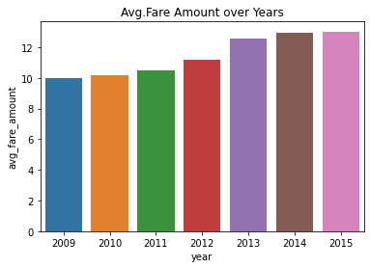
Exploratory Data Analysis (EDA)
All the coordinate columns: pickup_longitudes, pickup_latitudes, dropoff_longitudes and dropoff_latitudes were transformed to distance using Haversine method.
Distance column created from the above.
Pickeup_datetime converted
to Hour, minute, date, day,
month and Year.
On the right is the
avg_fare_amount over the year.

Slide 7
Model Assessments
Performance of our models would be assessed based on 2 metrics: root mean squared error and mean absolute percentage error.
Mean absolute percentage error (MAPE) describes the average percentage error of the predictions derived from the mean absolute error.
Root mean squared error (RMSE) defines the difference between the predictions of a model, and the corresponding ground truth.

Slide 8
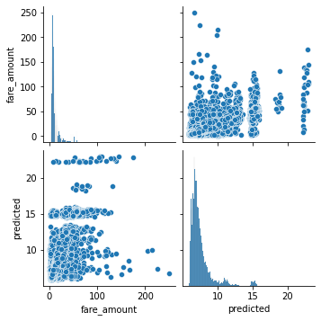
Machine Learning - ML
Five Models were deployed in this investigation:
XGBoost
LightGBM
Ridge Regression
RandomForestRegressor
Ordinary Least Square (OLS)
First model to test: XGB, has following params:-
objective = reg:linear, learning rate = 0.1,
max_depth = 5, n_estimators = 10
train_test_split ratio➔2:8
Table 1 show the sample of
actual and predicted fare values.
Index | Actual | Predicted
1 | 7.50 | 7.27
2 | 11.30 | 6.94
3 | 16.67 | 7.16
4 | 8.50 | 7.73
5 | 10.50 | 7.60
6 | 5.00 | 6.90
7 | 5.00 | 6.92

Slide 9
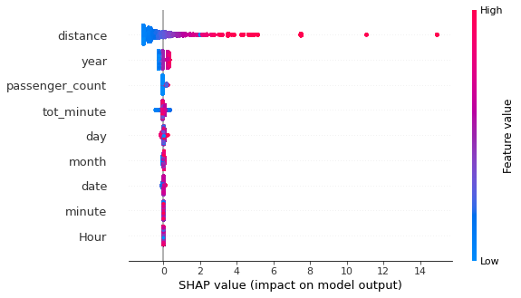
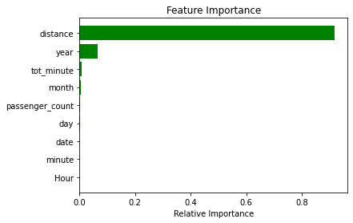
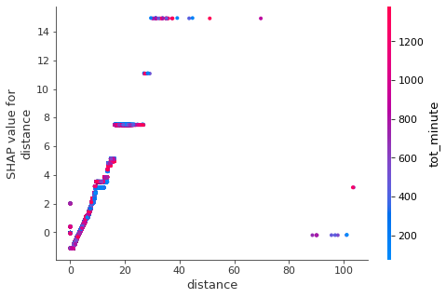
Machine Learning [contd.]
Shap summary plot
Dependence shows distance not depending on tot_minutes:
Feature importance of XGB shows that distance contributed to fare changes:
And shap summary plot confirms this:

Slide 10
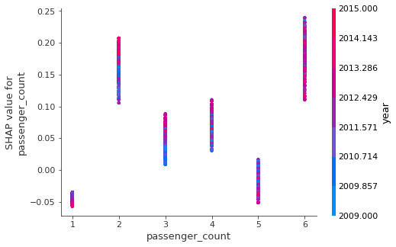
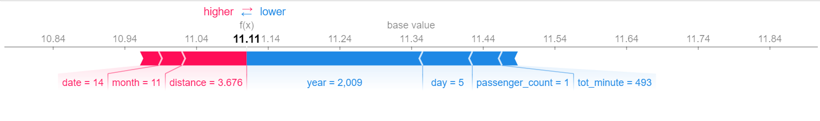
Machine Learning [contd.]
Passenger count shap dependence shows year over
Passenger count.
Shap values for the 10th observation
As seen above red is positive impact while blue is negative effect.
XGBoost RMSE was 9.15 but after some params adjustment it became 4.94.
Its MSE also dropped to 24.50 from 83.64. MAPE was 476.23.

Slide 11
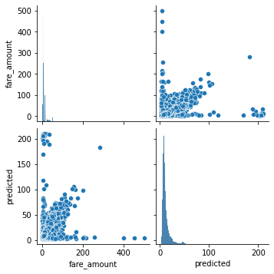
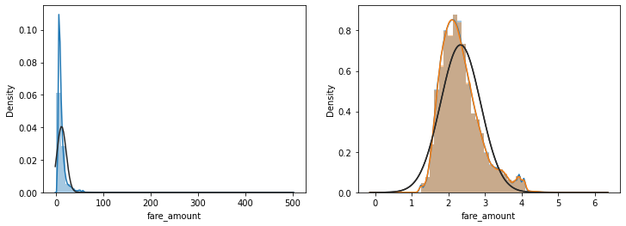
ML[contd.]
LightGbm is our second model with params:
objective = regression, learning Rate=0.005,
max_depth = 8, bagging fraction = 0.7,
feature fraction = 0.9
Table a shows actual and predicted fare amount
Figure(a) shows predicted distribution and correlation
between actual and predicted:
Index | Actual | Predicted
1 | 5.70 | 7.46
2 | 4.50 | 4.94
3 | 8.50 | 9.09
4 | 29.30 | 23.95
5 | 7.30 | 6.88

Slide 12
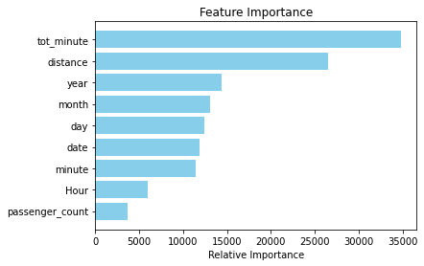
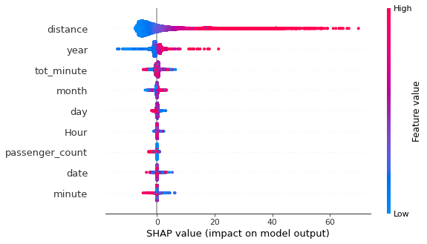
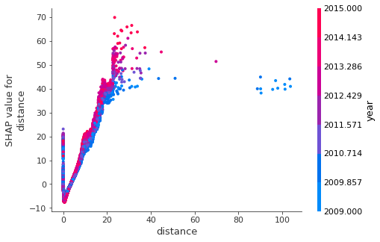
Feature importance shows all the effects other variables have on the fare, tot minutes taking lead.
In contrast, shap summary indicates
how effective distance and year on fare:
Figure bottom right shows the dependence of
distance and year

Slide 13
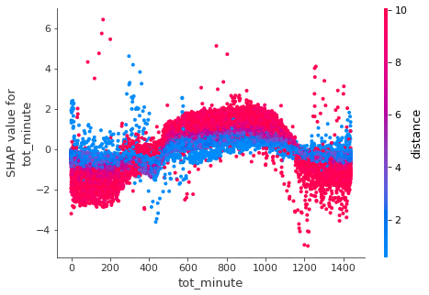
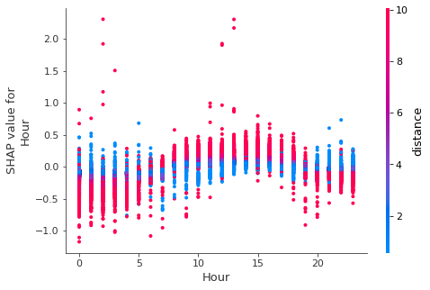
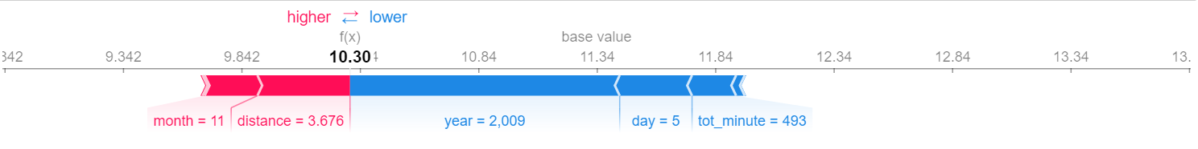
Another shap dependence of Hour on passenger count:
On the bottom
right is the 10th
observation for
force-plot.
Lightgbm model
has RMSE as 0.246
R_squared 0.79
MSE = 20.22
MAPE = 201
shap-force plot

Slide 14
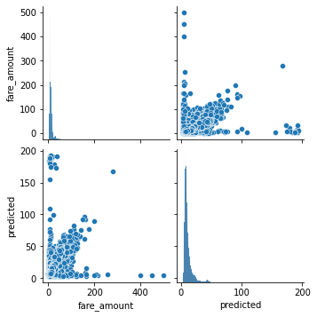
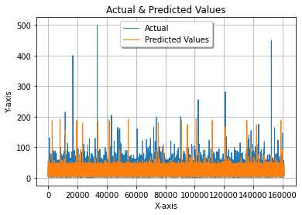
Ridge Regression is another ML model used for taxi fare prediction.
Table shown here shows the actual and predicted fare
Top right shows the actual and
predicted fare values.
RMSE = 16.71, MAPE = 265.
Index | Actual | Predicted
1 | 6/50 | 6.69
2 | 6.90 | 6.82
3 | 2.90 | 5.25
4 | 6.50 | 9.64
5 | 4.90 | 4.61
6 | 8.00 | 11.17
7 | 54.54 | 31.92

Slide 15
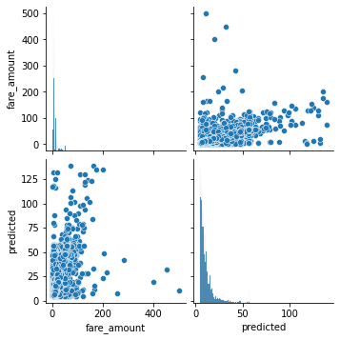
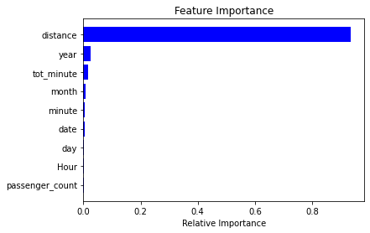
RandomForestRegressor: params used in the model includes max_depth = 10, n_jobs = -1, n-estimators = 10
The predicted values are shown in the table below:
The figure below shows how the actual
actual and predicted fare appear
Feature importance shows distance
leading:
Index | Actual | Predicted
1 | 6.5 | 6.06
2 | 6.9 | 6.15
3 | 2.9 | 4.69
4 | 6.5 | 9.13
5 | 4.9 | 4.72

Slide 16
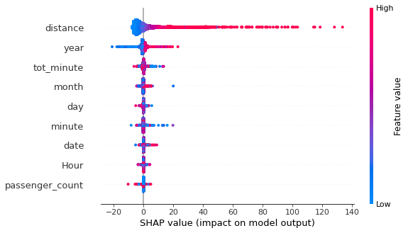
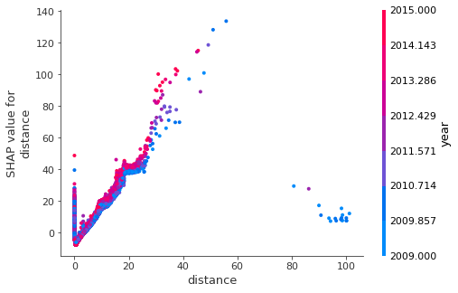
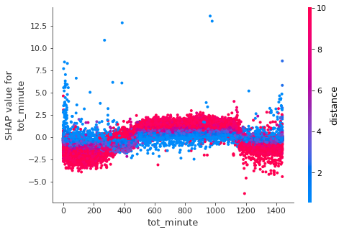
In the summary plot, distance and year as contributory variables to the fare amount.
The shap dependence
of distance with year.
Tot minute and distance dependence
b
m

Slide 17
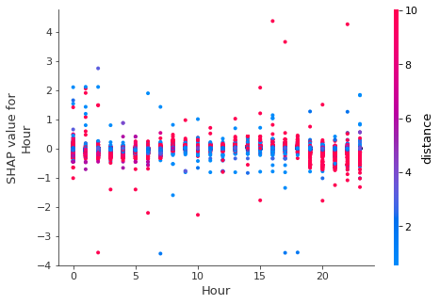
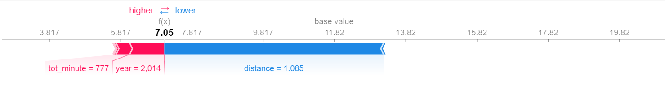
RandomForestRegressor model for shap dependence between hour and distance is shown below
RMSE is 11.99 with MSE of 23.98
and MAPE of 213 and its
R_squared = 0.76
The model can improve if the
parameters of the regressor is
adjusted. Force plot of 10th observation shows tot minute and year
high while distance is
lower.

Slide 18
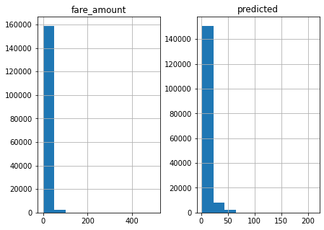
OLS – Ordinary Least Square Regression model was tried out.
Results Show how the Actual and
redicted aligned, see table below.
Presented are the distributions
of Actual and Predicted values
of the fare.
The RMSE is low compared to Ridge
and Random Forest. RMSE = 5.70, MSE =
32.43 and MAPE = 249
Index | Actual | Predicted
1 | 6.50 | 6.23
2 | 6.90 | 6.37
3 | 2.90 | 4.66
4 | 6.50 | 9.52
5 | 4.90 | 3.90
6 | 8.00 | 11.16
7 | 54.54 | 33.97

Slide 19
The general performances of the models deployed shown by the scores in the table below:
Most often these models can improve their performances if the parameters are tuned by adjusting their hyperparameters.
MODEL | RMSE | MSE | MAPE | R²
XGBOOST | 9.15(4.95) | 83.64(24.50) | 47.625 | 1.0
LIGHTGBM | 0.2469 | 20.22 | 20.4 | 0.79
RANDOMFOREST | 11.99 | 23.98 | 21.3 | 0.76
RIDGE | 16.71 | 33.43 | 26.5 | 0.65
OLS | 5.70 | 32.43 | 24.9 | 0.67

Slide 20
CONCLUSION
Five techniques were employed to determine the Taxi fare_amount predictions.
These models are XGBoost, LightGBM, Ridge, RandomForestRegressor and Ordinary Least square(OLS)
LightGBM whose RMSE is 0.2465 shows a better predictor.
The key parameters that influenced the prediction are distance and time.
1% or 550000 was used in this study out of the 55million rows of dataset.

Slide 21
Recommendations
LightGBM, best-selected model based on its metric, robustness, fastness and very low RMSE.
It would guide taxi fleet operators to know the fare range to charge their commuters as distance, locations and time indicators show.
This model is easy to deploy operationally by taxi fleet operators, and commuters as well. And would be a great compass for operators against overcharging their customers.
The model can generate predictions within milliseconds, and it’s known to have a low computational requirement.
A real-time web application can be developed based on this algorithm for this market segment.

Slide 22
Thank You

